Slide 1
Module 9: Well-Architected Pillar 1: Operational Excellence
Notes:
Welcome to Module 9, where you will learn about the first pillar of the Well-Architected Framework: Operational Excellence.
The Operational Excellence pillar was introduced at re:Invent 2016 and became pillar 1 in 2017. This module focuses on how to design. It does not focus on how things run in production. The majority of testing focuses on whether a system is ready to go live, but does not often consider how you architect for runtime. While you draw your first design on a napkin, think about these questions: How easy is this going to be to operate? What processes are needed? Who is going to operate it? The code you use to operate your workload is the management plane of the product. The three planes are:
The Control plane creates resources.
The Data plane uses resources.
And the management plane configures the service.
Operational excellence is challenging to achieve in traditional on-premises environments, where operations is perceived as a function that is isolated and distinct from the lines of business and development teams that it supports. By adopting the practices in the Well-Architected Framework, you can build architectures that provide insight to their status, are enabled for effective and efficient operation and event response, and can continue to improve and support the goals of the business.
AWS Support is the main AWS service that enables how you define operational priorities. It provides a combination of tools and expertise to help you define your organization’s goals on AWS. The following services and features are also important:
AWS CloudFormation
AWS Config
Amazon CloudWatch
And Amazon Elasticsearch Service

Slide 2
What’s in This Module
Part 1: Principles of the Operational Excellence Pillar
Part 2: Drive Operational Excellence
Part 3: Operational Excellence Pillar Questions
Notes:
In part 1, we’ll reveal the principles of the Operational Excellence Pillar.
In part 2, we’ll identify some ways to drive operational excellence.
And in part 3, we’ll ask a series of operational excellence pillar questions and reveal some best practices.

Slide 3
Module Objectives
Describe the benefits and application of the Operational Excellence pillar, including running and monitoring systems to deliver business value and to continually improve processes and procedures.
Identify the design principles and best practices of the Operational Excellence pillar.
Notes:
Upon completing this module, you will be able to:
• Describe the benefits and application of the Operational Excellence pillar, such as running and monitoring systems that will deliver business value, and continually improve processes and procedures.
• Identify the design principles and best practices of the Operational Excellence pillar.
These recommendations and best practices are based on the wealth of experience and knowledge that the AWS team of experts have gained, based on work with numerous customers. They are not meant to be hard-and-fast rules, unless they are specified as a rule. The goal of these recommendations is to make sure you can evaluate the options for structuring systems, and to provide questions that you can ask during a design review. These questions can help ensure that you can justify and support your decisions with a reason, such as cost, security, governance, or another driver.

Slide 4
Principles of the Operational Excellence Pillar
Notes:
As we begin, let’s discuss the principles of the Operational Excellence pillar.

Slide 5
Pillar 1: Operational Excellence
The ability to run and monitor systems to deliver business value and continually improve supporting processes and procedures.
Prepare
Operate
Evolve
Notes:
Operational excellence is the ability to run and monitor systems so they can deliver business value and continually improve supporting processes and procedures.
The three best practice areas for operational excellence in the cloud are to prepare, to operate, and to evolve.
• Effective preparation is required to drive operational excellence.
• The successful operation of a workload is measured by the achievement of business and customer outcomes.
• The evolution of operations is required to sustain operational excellence.
Operations teams must understand the needs of their business and their customers so they can effectively and efficiently support business outcomes. Operations creates and uses procedures to respond to operational events, and they validates the effectiveness of these procedures to support the needs of the business. Operations collects metrics that are used to measure whether business outcomes are achieved. Everything continues to change, including the context of your business, the priorities of your business, the needs of your customer, and so on. It’s important to design operations so they can evolve over time in response to change, and to incorporate lessons that were learned through their performance.

Slide 6
Design Principles
Perform operations with code.
Annotate documentation.
Make frequent, small, reversible changes.
Refine standard operations procedures frequently.
Anticipate failure.
Learn from all operational failures.
Notes:
In the cloud, you can follow a number of design principles drive operational excellence. Let’s discuss each principle in more detail.
• Remember to perform operations with code. In the cloud, you can apply the same engineering discipline that you use for application code to your entire environment. You can define your entire workload—such as applications, infrastructure, and so on—as code, and you can update your workload with code. You can script your operations procedures and automate their execution by triggering them in response to events. By performing operations as code, you limit human error and enable consistent responses to events.
• Always annotate documentation changes. In an on-premises environment, documentation is created by hand, used by people, and hard to keep in synchronization with the pace of change. In the cloud, you can automate the creation of documentation after every build, or you can automatically annotate hand-crafted documentation. Annotated documentation can be used by people and systems. Use annotations as an input to your operations code.
• Make frequent, small, reversible changes. You want to design workloads to allow components to be updated regularly. Make changes in small increments that can be reversed if they fail, and when possible, without affecting customers.
• Refine standard operations procedures frequently. As you use operations procedures, look for opportunities to improve them. As you evolve your workload, evolve your procedures appropriately. Set up regular game days to review and validate that all procedures are effective, and that teams are familiar with them.
• Anticipate failure, as it can happen. Perform “pre-mortem” exercises to identify potential sources of failure, so that they can be removed or mitigated. Test your failure scenarios and validate your understanding of their impact. Test your response procedures to ensure they are effective, and that teams are familiar with how to execute these procedures. Set up regular game days to test workloads and team responses to simulated events.
• Learn from all operational failures. Drive improvement through lessons that you learned from all operational events and failures. Share what is learned across teams and through the entire organization.

Slide 7




Key Services
Areas | Key Services
Prepare
Operate
Evolve
AWS
CloudFormation
AWS Config
Amazon CloudWatch
Amazon
Elasticsearch
Notes:
AWS CloudFormation is key for operational excellence because it helps you ensure reliability. The service lets you treat infrastructure as code, and it provides templates you can use to replicate your environment.
Let’s identify key services for each area of the Operational Excellence pillar.
• To prepare, AWS Config and AWS Config Rules can be used to create standards for workloads, and to determine whether environments are compliant with those standards before they are put into production.
• CloudWatch allows you to monitor the operational health of a workload.
• And Amazon Elasticsearch Service allows you to analyze your log data to gain actionable insights quickly and securely.

Slide 8
Driving Operational Excellence
Notes:
Now, let’s identify some ways to drive operational excellence.

Slide 9
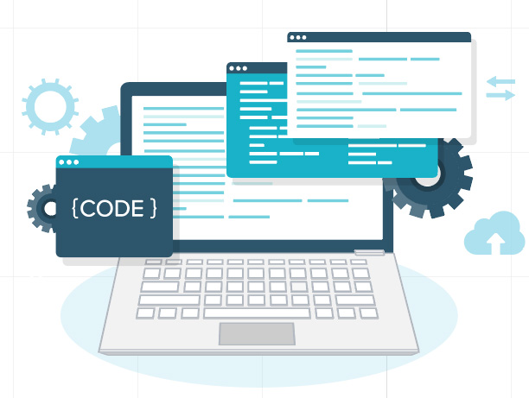
Anti-patterns
Manual changes
Technology metrics
Batch changes
No time to learn from mistakes
Stale documentation
Notes:
First, let’s take a look at the anti-patterns, or what you don’t want to do.
• Don’t commit manual changes because mistakes can happen, and then these mistakes will be hard to reproduce.
• You don’t want to focus on technology metrics alone. Your central processing unit—or CPU—and memory might be in good shape, but you might not be delivering value to the customer if you’re not paying attention to latency.
• When it comes to batch changes, getting changes approved and pushing them through can be cumbersome. Instead of making small, reversible changes, you might want to batch them. However, batching can make it difficult to troubleshoot if there are issues.
• If a mistake is made, always take the time to understand what went wrong, to make sure it doesn’t happen again.
• Having outdated documentation or no documentation can create problems. Put a process in place to ensure all documentation is up-to-date.

Slide 10
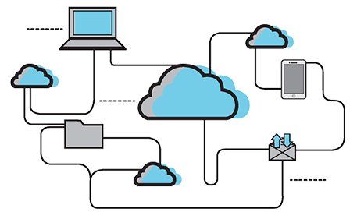
AWS Environment
Perform operations with code.
Align operations processes to business objectives.
Make regular, small, incremental changes.
Test for responses to unexpected events.
Learn from operational events and failures.
Keep operations procedures current.
Notes:
In the AWS environment, you can use the design principles of the Operational Excellence pillar to make all changes by code, and with business metrics that you can measure your success against.
You want to align your operations processes to meet your business objectives.
By automating change and using code, you can move to a model of making regular incremental changes, and reducing risk. You can use orchestration tools to roll out and implement your changes.
You want to test for responses to unexpected events in a test environment before you roll out to production. You can build organizational “muscle memory” by running game days that simulate failures to test your recovery processes. Learn from these activities, and from other operational events or failures to improve your responses.
Finally, keep standard operations procedures current. Because your infrastructure is now code, you can detect when documentation is out-of-date, and even generate documentation.

Slide 11

Best Practice: Prepare
Monitor application, platform, and infrastructure components.
As well as customer experience and behaviors.
Validate workloads before moving to production
Are they supported by operations?
Perform Cloud operations
Checklist (standard and required procedures).
Guidance (runbooks and playbooks).
Validate trained personnel.
Test responses to operational events and failures.
Notes:
Effective preparation is required to drive operational excellence.
To prepare, you want to monitor the application, platform, and infrastructure components. You can use CloudWatch alarms, and send the information from CloudWatch logs to a dashboard to see the health of your infrastructure at any time. You can use this information to understand the customer experience and customer behaviors.
You want to be sure to validate workloads before moving into production. Ask yourself: are the workloads supported by operations?
For cloud operations, you want to:
• Use Checklist for standard and required procedures, which will help ensure that everything that has happened on the system and that’s been tested, has been done.
• Check that required procedures are adequately captured in runbooks and playbooks.
• Validate trained personnel to make sure everyone is enabled.
Finally, make sure you test responses to operational events and failures so that you can quickly recover from them.

Slide 12





Prepare With AWS Services
AWS CloudFormation
Amazon CloudWatch
AWS CloudTrail
flow logs
Operations as code
Safe experimentation
Operations procedures
Practice failures
Log collection
Monitoring
Data on use of resources
APIs
Notes:
This slide covers how to prepare with AWS services. You can use AWS CloudFormation to implement your code as infrastructure, safely experiment, develop operations procedures, and practice failure. Using AWS CloudFormation enables you to have consistent and templated sandbox environments for development, test, and production, with increasing levels of operations control.
AWS enables visibility into your workloads at all layers through various log collection and monitoring features. Data on the use of resources, application programming interfaces, and network flow logs can be collected using CloudWatch, AWS CloudTrail, and Amazon Virtual Private Cloud—or Amazon VPC—Flow Logs. You can use the CloudWatch Logs agent, or the collected plugin, to aggregate information about the operating system into CloudWatch.

Slide 13
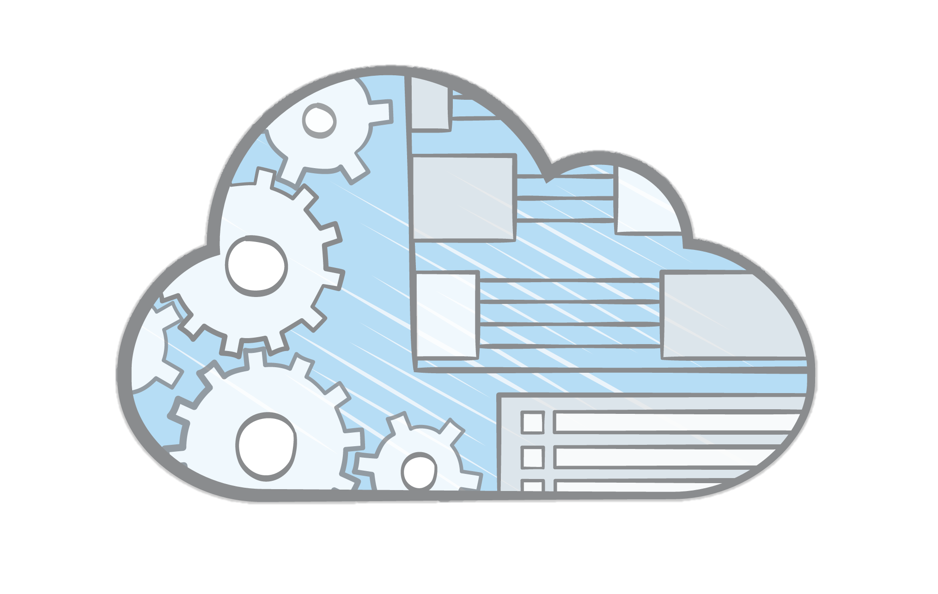
Best Practice: Operate
Achieve business and customer outcomes through successful operation of a workload.
Manage operational events with efficiency and effectiveness.
Communicate operational status of workloads.
Dashboards and notifications.
Determine the root cause of unplanned events and unexpected impacts from planned events.
Notes:
Let’s review some best practices for the operate area of the Operational Excellence pillar.
You can achieve business and customer outcomes through the successful operation of a workload.
Manage operational events with efficiency and effectiveness. You can do this by establishing baselines that you use to identify the improvement or degradation of operations, collecting and analyzing your metrics, and then validating your understanding of how you define operational success and how it changes over time.
Communicate the operational status of workloads. Consider that operational health includes both the health of the workload, and the health and success of the operations that act upon the workload—for example, deployment and incident response.
Use dashboards and notifications so that information can be accessed automatically. The more people have access to information about the health of your infrastructure, the healthier it will be.
If there is an unplanned outage, take the time to determine the root cause of the outage. Doing so will help mitigate future occurrences and unexpected effects from planned events.

Slide 14
Operate With AWS Services
Amazon CloudWatch
AWS CloudTrail
flow logs
Amazon CloudWatch
Generate dashboard views of your metrics
Workload insights through logging capabilities
Notes:
Best practices for operating with AWS services include using CloudWatch to keep your infrastructure healthy. You can generate dashboard views of your metrics, which are collected from workloads and natively from AWS.
You can use CloudWatch or third-party applications to aggregate and present business, workload, and operations-level views of operations activities. AWS provides workload insights through logging capabilities—such as AWS X-Ray, CloudWatch, CloudTrail, and Amazon VPC Flow Logs—which enable the identification of workload issues in support of root cause analysis and remediation.

Slide 15
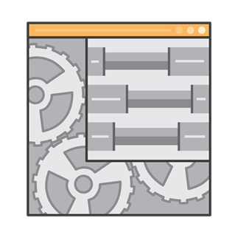
Best Practice: Evolve
Dedicate work cycles to making continuous incremental improvements.
Regularly evaluate and prioritize opportunities for improvement.
Identify areas for improvement with feedback loops.
Share lessons learned across teams.
Analyze trends.
Perform cross-team retrospective analysis of operations metrics.
Identify opportunities and methods for improvement.
Implement changes and evaluate results.
Notes:
Now, let’s review best practices for the evolve area of the Operational Excellence pillar.
The evolution of operations is required to sustain operational excellence.
Dedicate work cycles to making continuous incremental improvements.
Regularly evaluate and prioritize opportunities for improving procedures for both workloads and operations, such as feature requests, issue remediation, and compliance requirements.
Identify areas for improvement, and include feedback loops within your procedures.
Share “lessons learned” across teams to share the benefits of those lessons. Analyze trends within the lessons learned, and perform cross-team retrospective analysis of operations metrics so that you can identify opportunities and methods for improvement. Implement changes that are intended to bring about improvement, and evaluate the results to determine success.

Slide 16






Evolve With AWS Services
AWS
CodeStar
AWS CodeCommit
AWS CodeBuild
AWS CodeDeploy
AWS CodePipeline
AWS
X-Ray
AWS Developer Tools
Notes:
Evolving with AWS Services can also include your developers. AWS has an entire suite of tools just for developers that you can use. These tools include AWS CodeStar, AWS CodeCommit, AWS CodeBuild, AWS CodeDeploy, AWS CodePipeline, and X-Ray.
With AWS developer tools, you can implement build, test, and deployment activities for continuous delivery. You can use the results of deployment activities to identify opportunities for improving both deployment and development. You can perform analytics on your metrics data by integrating data from your operations and deployment activities, which enables you to analyze the impact of those activities against business and customer outcomes. This data can be used in cross-team retrospective analysis to identify opportunities and methods for improvement.

Slide 17
Operational Excellence Pillar Questions
Notes:
In this final section, we’ll ask a question that relates to operational excellence, and then reveal some best practices.

Slide 18

Operational Excellence Question #1
What factors drive your operational priorities?
Best practices
Business needs: Business and development teams in setting operational priorities.
Compliance requirements: External factors may obligate your business to satisfy specific requirements.
Risk management: Balance the risk of decisions against their potential benefit.
Notes:
What factors drive your operational priorities?
Best practices for understanding these factors include:
• Involving the business and development teams when you set operational priorities.
• Following compliance requirements. External factors—such as regulatory standards or industry standards—might obligate your business to satisfy specific requirements. An example of a requirement is considering Sarbanes-Oxley—or SOX—regulatory compliance requirements versus payment card industry —or PCI—best practices.
• Engaging in risk management to balance the risk of decisions against their potential benefit.

Slide 19
Operational Excellence Question #2
How do you know that you are ready to support a workload?
Best practices
Continuous improvement culture
Shared understanding of the value to the business
Documented and accessible governance and compliance
Checklists
Runbooks
Playbooks
Practice recovery
Notes:
How do you know that you are ready to support a workload?
Best practices for determining whether you are ready to support a workload include:
• Continuously improving your culture. This best practice governs the way you operate. You must recognize that change is constant, and that you need to continue to experiment and evolve by acting on opportunities to improve.
• Having a shared understanding of the value to the business. Make sure that you have cross-team consensus on the value of the workload to the business, and that you have procedures that you can use to engage additional teams for support.
• Ensuring that you have enough personnel so that you can have an appropriate number of trained personnel to support the needs of your workload. Perform regular reviews of workload demands, and train existing personnel or adjust personnel capacity as needed.
• Making sure that governance and guidance are documented and accessible.: Ensure that standards are accessible, readily understood, and measurable for compliance. Make sure that you have a way to propose changes to standards, and request exceptions.
• Using checklists to evaluate whether you are ready to operate workloads. These checklists include operational readiness checklists and security checklists.
• Having runbooks for events and procedures that you understand well.
• Having a playbook for failure scenarios.
• Practicing recovery so that you can identify potential failure scenarios and test your responses—for example, game days, and failure injection.

Slide 20
Operational Excellence Question #3
What factors drive your understanding of operational health?
Best practices
Define expected business and customer outcomes
Identify success metrics
Identify workload metrics
Identify operations metrics
Establish baselines
Collect and analyze your metrics
Validate insights
Have a business-level view of operations
Notes:
What factors drive your understanding of operational health?
Best practices for understanding operational health include:
• Defining expected business and customer outcomes. Make sure that you have a documented definition of what success looks like for the workload, from business and customer perspectives.
• Identifying success metrics. Define metrics that can be used to measure the behavior of the workload against the expectations of the business and of customers.
• Identifying workload metrics. Define metrics that can be used to measure the status—and the success—of the workload and its components.
• Identifying operations metrics. Define metrics that can be used to measure the execution of operations activities, such as runbooks and playbooks.
• Establishing baselines for metrics so that they provide expected values as the basis for comparison.
• Collecting and analyzing your metrics. Perform regular, proactive reviews to identify trends and determine responses.
• Validating insights. Review the results of your analysis and responses with cross-functional teams and business owners. Adjust the responses as appropriate.
• Taking a business-level view of your operations. Determine whether you are satisfying customer needs, and identify areas that need improvement so that you can reach your business goals.

Slide 21
Operational Excellence Question #4
What factors drive your understanding of operational health?
Best practices
Determine priority of operational events based on business impact.
Event, incident, and problem management processes.
Process per alert.
Define escalation paths.
Identify decision makers.
Communicate status through dashboards.
Push notifications.
Root cause analysis process.
Communicate root cause.
Notes:
What factors drive your understanding of operational health?
Best practices for understanding operational health include:
• Determining the priority of operational events based on their impact on the business. When multiple events require intervention, priority is based on the business impact.
• Putting processes in place to handle event, incident, and problem management. Establish processes to address observed events, events that require intervention—such as incidents)—and events that require intervention but cannot currently be resolved, such as problems.
• Processing each alert. Any event for which you raise an alert should have a well-defined response, such as a runbook or playbook. The event should also have a specifically identified owner, such as an individual, a team, or a role.
• Defining escalation paths. Runbooks and playbooks should have a definition for what triggers an escalation, a process for escalation, and specifically identify the owners for each action. Escalations might include third parties, such as for example, vendors, AWS Support, and others.
• Identifying decision makers. When actions have a potential impact on business outcomes, you must identify decision makers who are empowered to make decisions regarding a course of action on the behalf of the organization.
• Communicating operating status through dashboards. Create dashboards that communicate the current operating status of the business. Dashboards should be tailored to the target audiences, such as internal technical teams, leaders, and customers. Examples include the CloudWatch dashboard, Personal Health Dashboard, and Service Health Dashboard.
• Pushing notifications to communicate with your users when the services they consume are being impacted, and when the services return to normal operating conditions, such as via email or SMS.
• Establishing a root cause analysis process that identifies and documents the root cause of an event.
• Communicating the root cause of an issue or event. Make sure that you understand the root causes of events and their impact, and communicate them as appropriate. Also make sure that you tailor your communications to the target audiences.

Slide 22
Operational Excellence Question #5
How do you evolve operations?
Best practices
Processes for continuous improvement
Drivers for improvement
Feedback loops
Lessons learned
Analysis of lessons learned
Operations metrics review
Implement changes
Notes:
How do you evolve operations?
Best practices for evolving operations include:
• Putting processes in place to support continuous improvement. Your operations processes include dedicated work cycles to make continuous incremental improvements possible. Opportunities can then be evaluated and prioritized for action.
• Integrating drivers for improvement. Consider the features, capabilities, and improvements that you want. Also consider which issues, bugs, and vulnerabilities cannot be accepted. Finally, also consider which updates are required to maintain compliance with your policies, or to maintain support from a vendor.
• Including feedback loops for procedures so that you can identify areas for improvement.
• Having procedures in place to capture and document lessons learned from the execution of operations activities, which means that they can be used by other teams.
• Analyzing lessons learned along with procedures so that you can identify trends in what you learned, and identify areas to investigate for improvement opportunities.
• Performing retrospective analysis of operations metrics with participants spanning the business to determine opportunities and methods for improvement.
• Implementing changes to facilitate improvement, and evaluating the results to determine whether the changes are successful.

Slide 23

Review
Understand the principles of the Operational Excellence Pillar.
Identified ways to drive operational excellence.
Discovered best practices for a well-architected system.
Complete:
Knowledge Assessment
Notes:
In review, you now:
• Understand the principles of the Operational Excellence pillar.
• Have identified ways to drive operational excellence.
• And have discovered best practices for a well-architected system.
To finish this module, please complete the corresponding knowledge assessment.
23

Slide 24
Up Next: Module 10: Well-Architected Pillar 2: Security
Notes:
The next module is Module 10: Well-Architected Pillar 2 – Security.

Slide 25
Thanks for participating!
© 2018 Amazon Web Services, Inc. or its affiliates. All rights reserved. This work may not be reproduced or redistributed, in whole or in part, without prior written permission from Amazon Web Services, Inc. Commercial copying, lending, or selling is prohibited. Corrections or feedback on the course, please email us at: aws-course-feedback@amazon.com. For all other questions, contact us at: https://aws.amazon.com/contact-us/aws-training/. All trademarks are the property of their owners.
Notes:
Thanks for participating!

